Slide 1
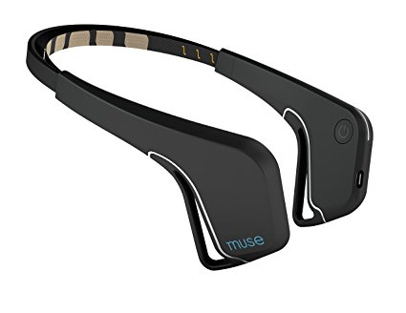
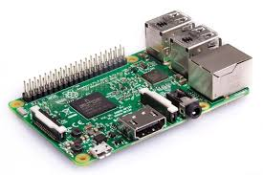
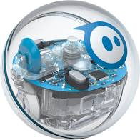
Team: Name (Abbreviated Name) |  | GitHub: Link
Scrum Master | Hardware Lead | Software Lead | Integration Lead
Name (Leads the team, runs the meetings, updates the Scrum board(s)) | Name (Leads the hardware, tracks the team hardware, manages purchase requests) | Name (Leads the software, tracks the team Github, manages the README) | Name (Leads the integration, manages the final deliverables including Manual)
Sprint Planning Board
Define what you will build this week, how, and who does what.
User Stories
ID | User Story | Acceptance Criteria | Priority
US0 | As a user, I want ____ so that ____. | Quantitatively defined | H/M/L
US1 | As a user, I want to see my biosignal live on screen. | Signal updates ≥20 Hz, visible filtering | H
US2 | As a user, I want my signal to control a device | Output changes within 200 ms | H
Sprint: # | Start: Date |  | End: Date
Sprint Goal
(1-2 sentences) Describe the working capability for this sprint
Definition of Done
Code pushed to GitHub Code well commented Hardware wired cleanly |  | Demo works live Short demo video recorded (≤1 min) README and Manual updated with instructions
Task Breakdown
Task | Linked User Story | Owner | Estimated Hours
Write MATLAB code to acquire sensor data | US1 | Name | 3
System Architecture
Input
Controls
Output
InteraXon Muse
EEG (µV)
AF7, AF8, TP10, TP9
BTLE
Raspberry Pi + PC
Average Engagement Index (0-1)
BTLE
Sphero
Speed (0-1)
Risks & Unknowns
Risk | Likelihood | Mitigation Plan
Noisy signal | H | Add shielding and digital filter
muselsl
Python
https://github.com/alexandrebarachant/muse-lsl
spheroSpeed
Python
https://github.com/zdanowiczkonrad/PythonSphero
~$200
https://choosemuse.com/
~$35
https://www.raspberrypi.org/
+ LSL
https://github.com/sccn/labstreaminglayer
~$100
https://sphero.com/

Slide 2
Team: Name (Abbreviated Name) | GitHub: Link
Standup Board
Go around the room and prepare a team summary of progress.
Sprint: # | Start: Date | End: Date
Around the Room Filled in by each individual before or during Standup
Scrum Master | Hardware Lead | Software Lead | Integration Lead
Name | Name | Name | Name
What I completed since last standup
What I’m working on today
Blockers (Be specific: hardware, code bug, merge conflict, unclear requirement, etc.)
GitHub Metrics Filled in by Software Lead before or during Standup
Metric | Value
# Commits
# Contributors
# Files Changed
Hardware List Filled in by Hardware Lead before or during Standup
Item | Status
Mikroe EEG Click Board | In team’s possession
Mikroe Shield | In team’s possession
Arduino Uno | In team’s possession
RC Car | Submitted for purchase request, ETA Date
Team Summary Filled in by Scrum Master during Standup
Question | Team Answer
Are we on track for our sprint goal?
Any major integration risks?
Do we need instructor help?

Slide 3
Team: Name (Abbreviated Name) | GitHub: Link
Retrospective Board
Reflect on this past week and propose improvements for the future.
Sprint: # | Start: Date | End: Date
Sprint Goal Recap
(1-2 sentences) Did you achieve it? Provide evidence – demo link, repo link, etc.
What We Learned
Technical | Team
Example | Example
What Went Well? | What Didn’t Go Well?
Signal filtering worked earlier than expected Good GitHub collaboration | (Be honest – this is graded on reflection, not perfection)
Process Improvements for Next Sprint
Problem | Change We Will Try
Only one person used GitHub | Require another teammate to review commits

Slide 4
Purchase Request Form
Team: Name (Abbreviated Name)
Date Submitted: Date
Item | Justification | Unit Cost | Number of Units | Total Cost | Purchase Link (Digikey, Amazon)

